Slide 1
RealEstate MarketPlace Shrish Pandey GLA University Computer Science and Engineering Date

Slide 2
Introduction
Real Estate Marketplace is a leading real estate agency that specializes in helping clients buy, sell, and rent properties in the most desirable neighborhoods.
The motivation behind Real Estate Marketplace is to create an online market where people can easily sell, buy and rent properties they are interested easily.
They can compare properties here easily to buy the most suitable one for them from the available listings.
Our web app provides efficient registering ans signing in option including google login option.

Slide 3
Objectives
Our mission is to help our clients achieve their real estate goals by providing expert advice, personalized service, and a deep understanding of the local market. Whether you are looking to buy, sell, or rent a property, we are here to help you every step of the way.

Slide 4
Problem Statement
The current real estate landscape, traditional methods of property transactions are often marred by inefficiencies, lack of transparency, and limited accessibility. Recognizing these challenges, the Real Estate Marketplace project aims to address the following key problems:
1. Fragmented Property Transactions:.
2. Limited Market Insight:
3. Security and Trust Concerns:
4. Inconsistent User Experience:
5. Limited Business Opportunities:
6. Competitive Analysis Gaps:

Slide 5
Literature Review
Related Project in the same domain
1. Real Estate Marketplace web app
Real Estate Marketplace is not just a platform; it's a community reshaping the real estate landscape. Whether you're a first-time homebuyer, a seasoned investor, or a property owner, our platform is your gateway to a seamless and efficient real estate experience.

Slide 6
Methodology
The project will employ the following methodologies, tools, and technologies:
• Programming Languages: Node JS (for Backend Development), React (for FrontEnd Development), MongoDB for database
• Software: VS Code, Firebase for backend services,
• Hardware: System for testing, Web server for hosting web components.

Slide 7
System Architecture
Login System
The app has an efficient way of logging in and signing up the user with the additional option of signing in with the gmail account.
Create Listing
The users can create property listing on their account which can be viewed by anyone accessing the site from their system.
View Listing and contact Landlord
The customer can view the listing and contact the landlord through their inbuilt mail service to negotiate .

Slide 8
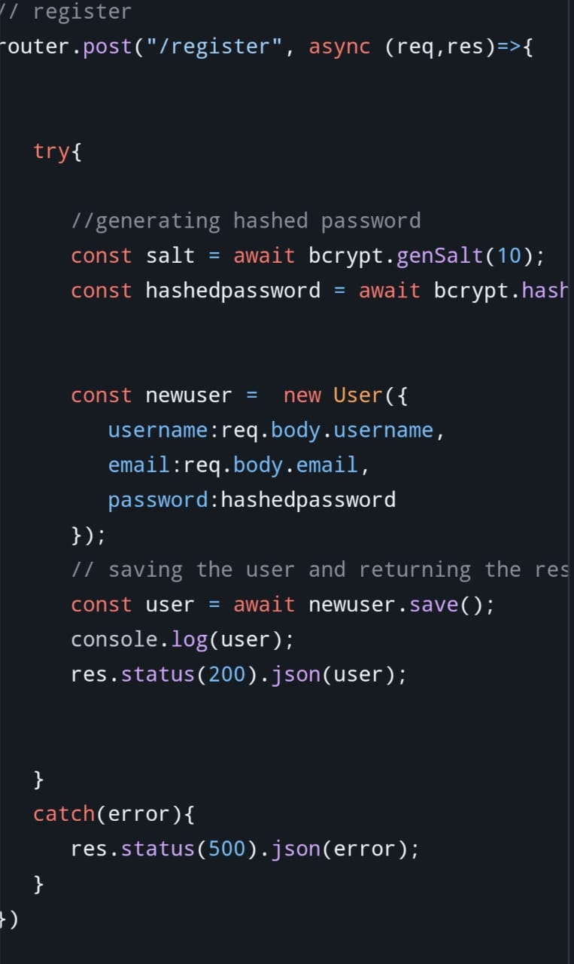
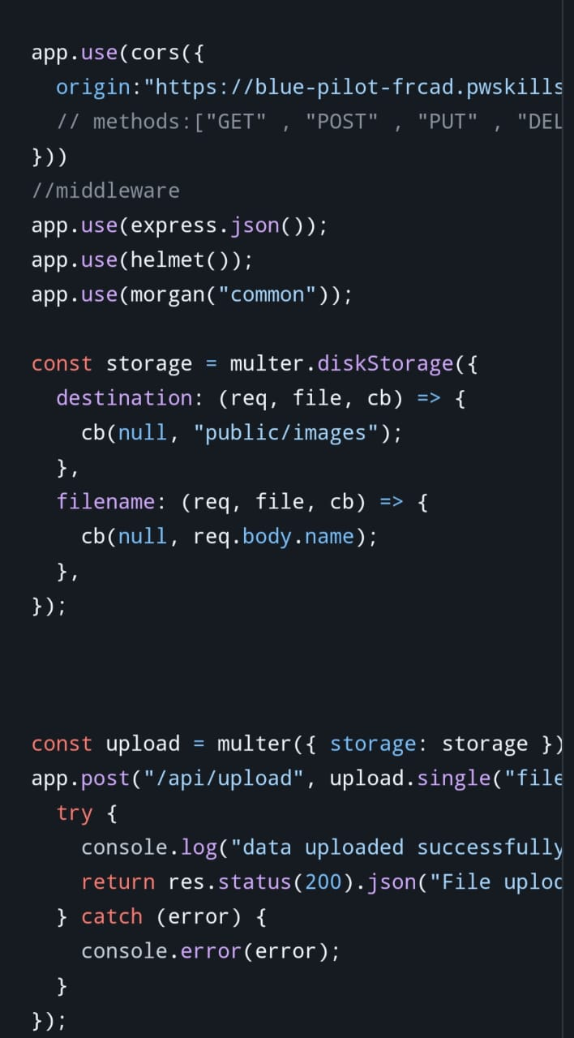
Implementation
Project Initiation and Requirement Analysis
UI/UX Design
Backend Development and Database Integration
Frontend Development
Integration
Testing and Quality assurance
Project Completion and Deployment

Slide 9
Features
User Registration and Profile Management
Property Details Sharing
View Listings
Search Listings
Contact Landlord
User Authentication and Data Security

Slide 10
Results
At the project's conclusion, Real Estate Marketplace will provide a efficient platform to check on real estate properties and buy/sell/rent these properties by contacting the landlord directly through their system inbuilt mail services.

Slide 11
Challenges Faced
Maintaining authenticity of a user
Preventing site from the vulgar content
Give authentication to some specific users

Slide 12
Conclusion
In conclusion, the Real Estate Marketplace project stands as a transformative force in property transactions. Combining technical excellence with user-centric design and a robust business model, it aims to redefine the real estate landscape. Meticulous technical evaluation ensures a high-quality codebase, while a focus on user experience positions the platform as intuitive and engaging. The business assessment provides entrepreneurs and investors with key market insights, fostering strategic decision-making. The comparative analysis propels effective marketing strategies. The Real Estate Marketplace isn't just a platform; it's a comprehensive solution poised to reshape real estate into a more accessible, transparent, and efficient ecosystem. Welcome to the future of property transactions.

Slide 13
Future Work
Additional features and functionalities
Voice and Video Calling
Chatbots and Automation
Language Translation

Slide 14
Acknowledgments
I would like to express our sincere gratitude to our Mentor Mr Ankit Arora for your guidance, advice and support ,which was invaluable throughout the project

Slide 15
Q&A
Questions……..

